Slide 1
Intelligent Cargo Management System Using IOT
B.Madhava Reddy
K.Yeswanth
G.Jaswanth

Slide 2
Project Description
Supply Chain Management consists of a number of phases in which the transportation plays an important role. The perishable products are to be delivered at the desirable quality in the right time. The lack of constant monitoring of the product during the freight contributes towards the food wastage during the transportation phase. The various factors that influence the freshness scale of the product which includes the natural and physical conditions are to be considered before the movement of the goods from the source to the destination.
The sensors are deployed inside the truck to monitor the freshness of the product. Various parameters like temperature, humidity and the air quality inside the truck are monitored. An app is designed for receiving all the parameters through Bluetooth communication. If the freshness level falls below the scale, then an SMS is sent to authorized person with the location of truck.

Slide 3
What can be solved?
We can prevent or reduce wastage of food.
By small modifications in hardware and the code we can use this system to prevent thefts in trucks and houses.
We can use this system not only in cargo trucks but also in pharmacies etc.

Slide 4
Working of System
Bluetooth Communication between Device and Mobile Application.
Usage of Bluetooth module and its configuration.
Building the mobile Application using Android ( MIT app inventor)
Sending the alert messages through the mobile application if required.

Slide 5
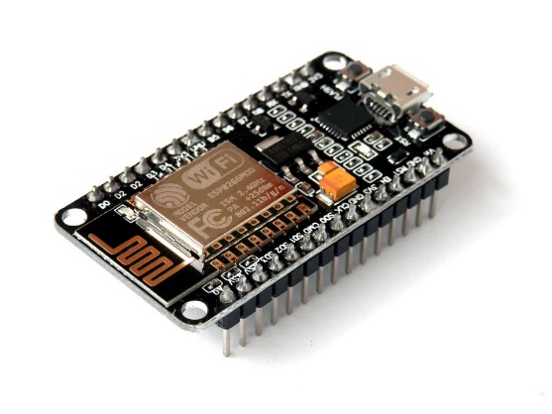
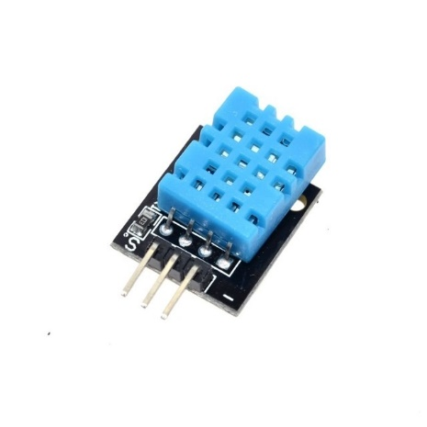
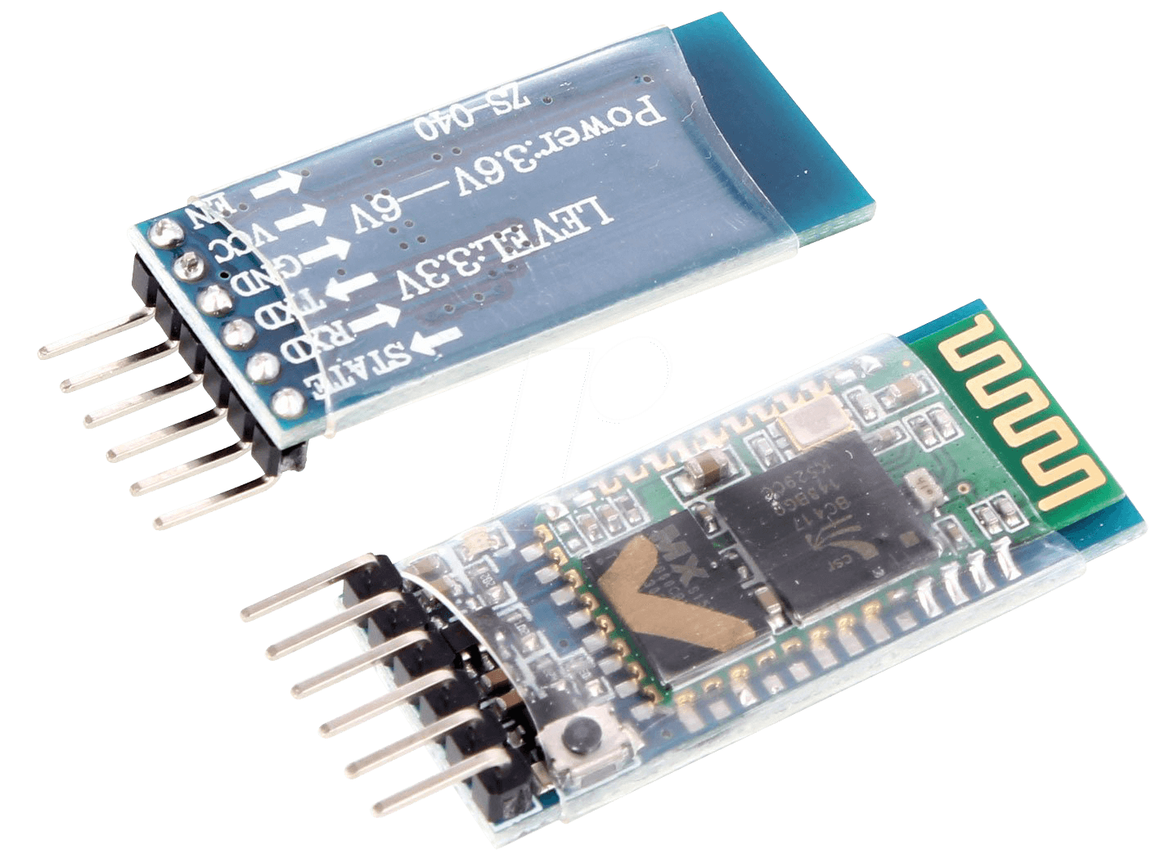
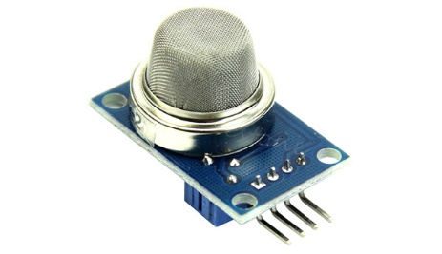
Hardware
DHT11
Node MCU
MQ 6
Bluetooth HC-05 module

Slide 6
Mobile Application
We used MIT app inventor to build this app.
The sensor data transmitted by the HC 05 module is received displayed in the app continuously.
Once the data is received we check whether the parameters are to the optimal condition.
If any parameter falls below the par level then an alert message is prompted on the screen and also a message is sent to the authorised official.

Slide 7
Conclusion
This work focuses on real tracking of goods, cargo vehicles by using IoT and open source hardware. By this system we can eliminate the delay delivery and theft of vehicles and can ensure quality of products.
Hence this Bluetooth system suits best for real time data monitoring. In this logistics management system the technology used were efficient and resulted in real time.
By small alternations,this system can be further enhanced and can extend its services to other applications.

